Slide 1
Project bug fixing Twillio-sharp
Project of SOEN691D course
Professor : P.Rigby
Prepared by : Manouchehr Azizi

Slide 2
Work steps
Finding a project with proper committers and commits
Finding architecture of project
Concentrate in one of subproject(Twilio.api) and gathering the class diagram and other information about it
understand Twilio Rest API related to bug List
Find out why bug exists and write change log and create patchset
geting professor feedback and submit the patch and implement

Slide 3
Bug list to fix
TwilioRestClient deserializes RestExceptions
CreateQueue overloads cause confusion
No way to filter subaccounts list by status or friendly name

Slide 4
Second Bug explanation
There are two overloads for CreateQueue, both of which take two two parameters. If you are using the overload that lets you set maxSize, and set it to null, this causes a conflict with the one that takes the Action

Slide 5
Third bug Explanation
No way to filter subaccounts list by status or friendly name

Slide 6
Project Architecture
In this part I find out Twillio-sharp solution consist of 8 projects in following category
Project category
Some of project related to project test
Some of project were developed in different framework such as : Silverlight, WindowsPhone, WebMatrix,...
My concentrate project Twillio.API which is developed in c# framework and class
You can find diagram of solution and project level view of architecture in: SOEN691_AZIZI\Architector\solution_projects.png

Slide 7
Twilio.api class diagram
Twilio.api is concentrated project between 8 projects
The information is gathering about it such as class diagram that you can find it in following adress: SOEN691_AZIZI\Architector\TwillioAPIClassDiagram.png

Slide 8
Find out why bug exist
Steps to find
Get an ACCOUNT SID and phone number from Twilio
Make a new project and add twillio NuGet
Writing the code to call or message
Build and run
Trace code and finding issue
You can see these steps in following images

Slide 9
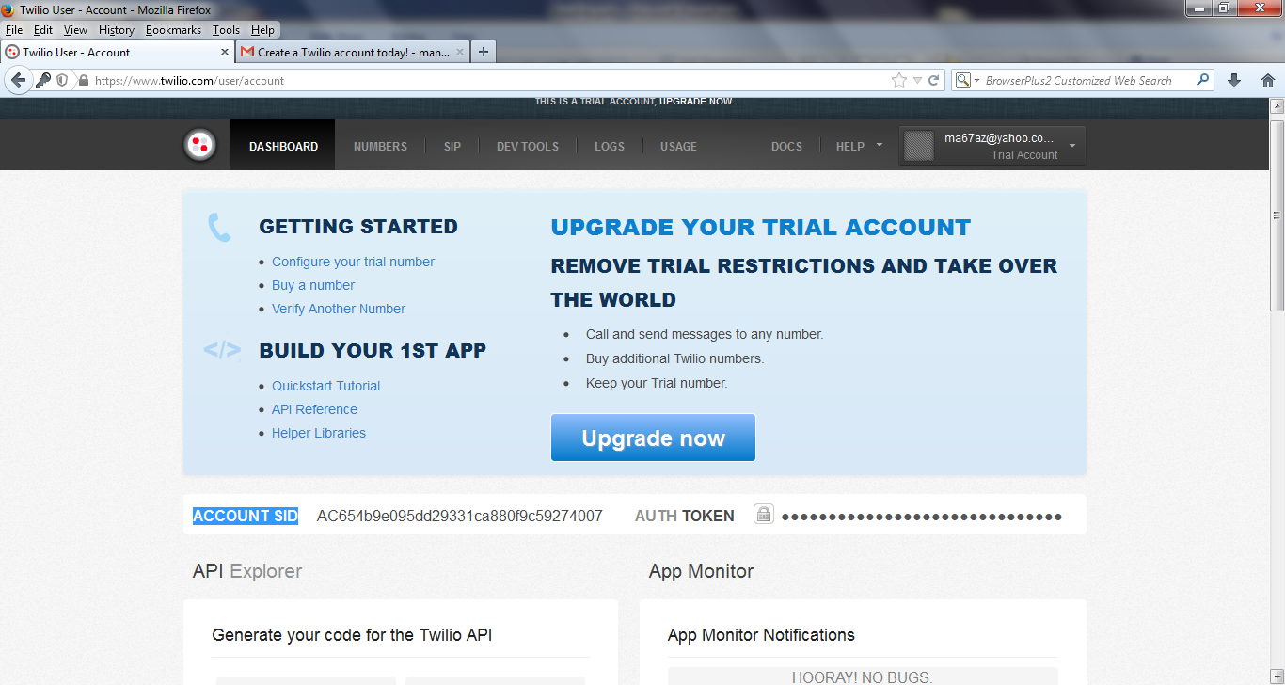
Twilio account

Slide 10
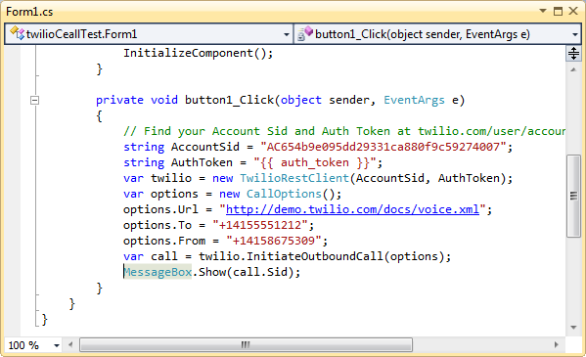
First Bug: Code for call

Slide 11
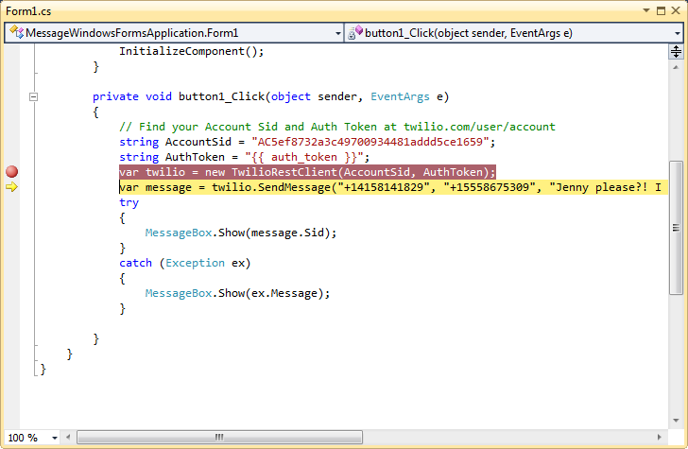
First Bug : code of using Twilio api send massage

Slide 12
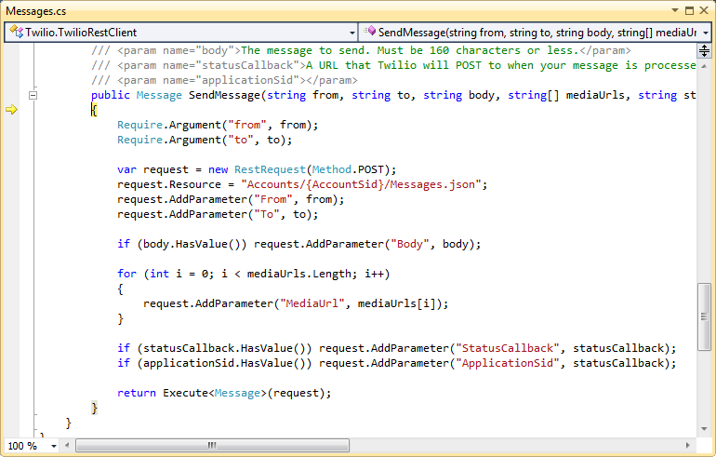
First Bug : Twilio core send massage

Slide 13
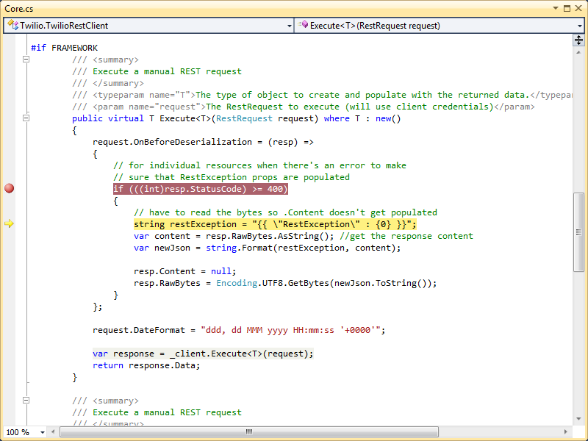
First Bug : RestException code line in Twilio core

Slide 14
First Bug : Root of deserializes RestExceptions
This issue ,as you see in “RestException code line in Twilio” image, is because of RestSharp Api in RestSharp.RestRequest service that is responsible to serialization and deserialization (is called marshall and unmarshal in java)
This API is out of this project zoon and this issue is reported as RestSharp Issues by Devin(Core developer)

Slide 15
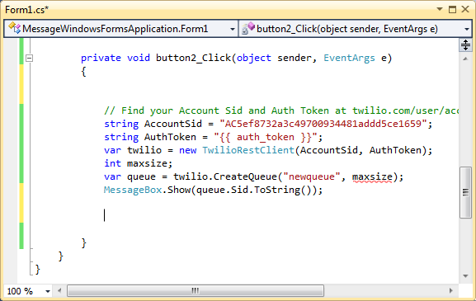
Second Bug: Code for using Twilio API

Slide 16
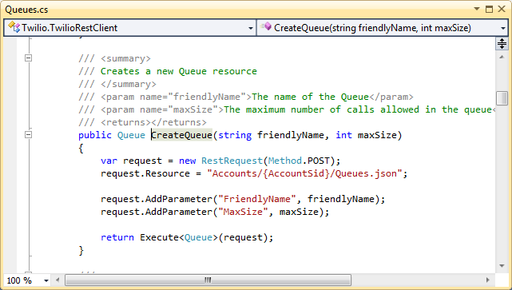
Second Bug: Core CreateQueue first overload

Slide 17
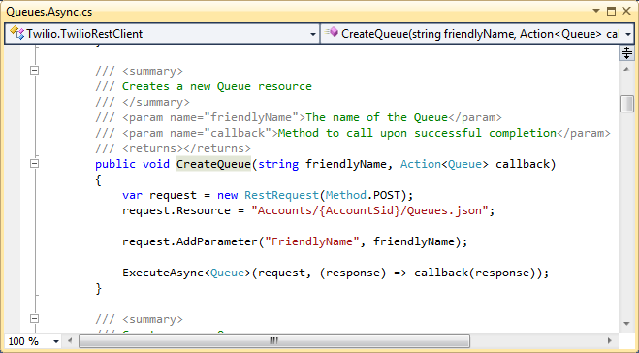
Second Bug: Core CreateQueue second overload

Slide 18
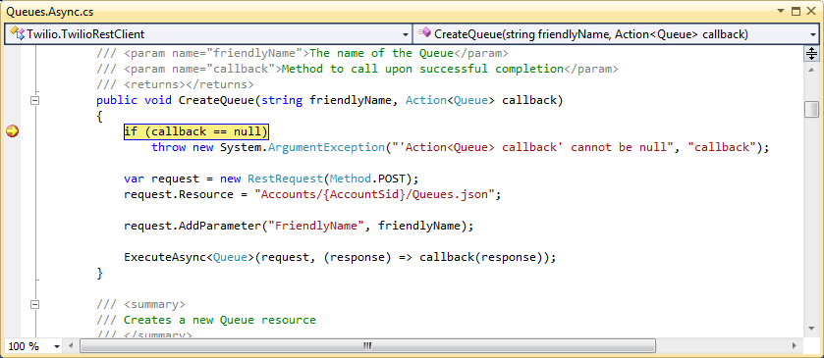
Second Bug: Solution(Argument Exception)

Slide 19
Second Bug: Root Issue and solution
There are two overloads for CreateQueue, both of which take two parameters. If you are using the overload that lets you set maxSize, and set it to null, this causes a conflict with the one that takes the Action
Solution: chek maxSize and do not allow to be null

Slide 20
References
Twilio REST API Documentation https://www.twilio.com/docs/api/rest
https://www.twilio.com/docs/api/rest/queue
https://www.twilio.com/docs/api/rest/subaccounts#listing-subaccounts-example-2

Slide 21
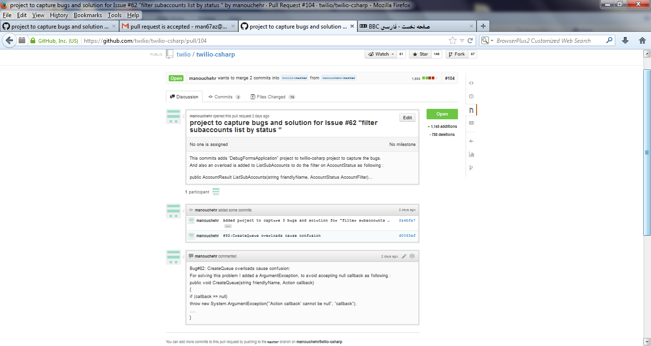
Pull request

Slide 22
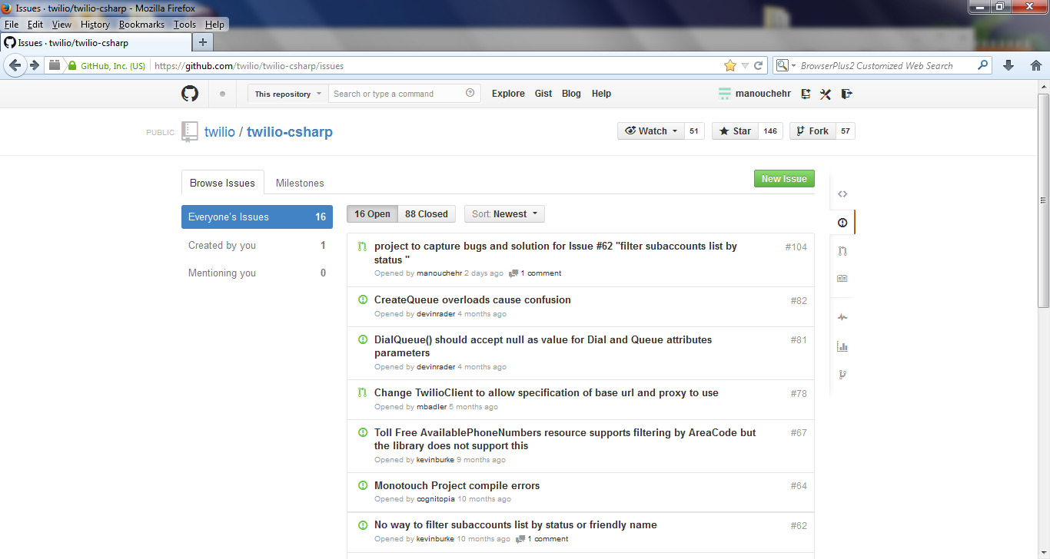
Pull request accepted by Twilio

